Slide 1
Promo Screen Shots
Wireframe designs

Slide 2
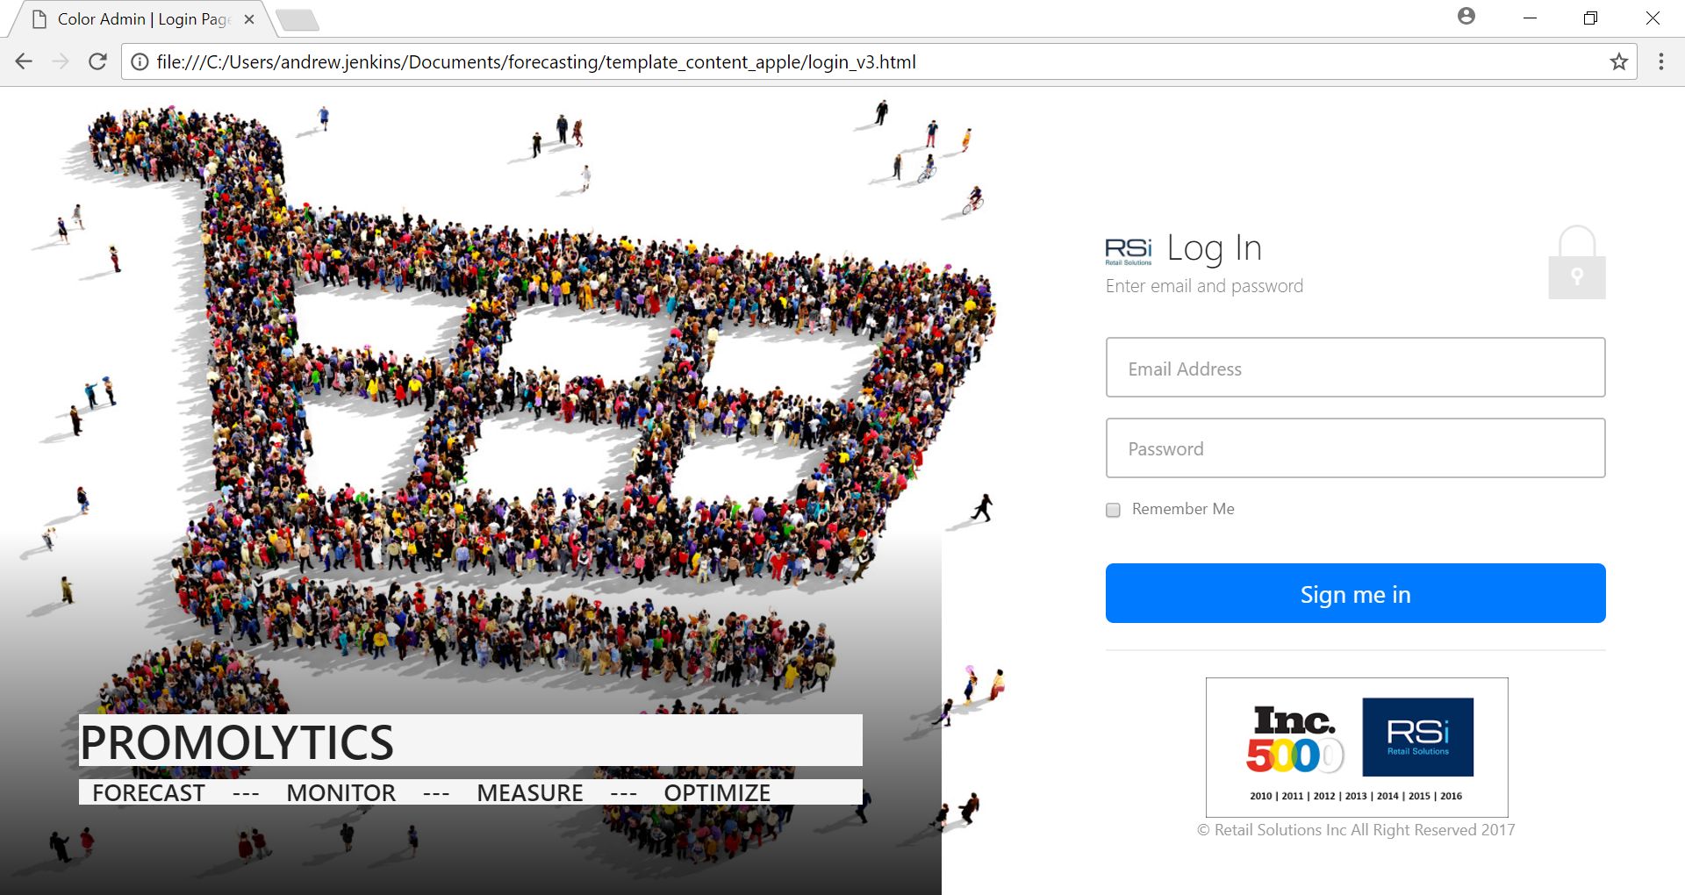
Login

Slide 3
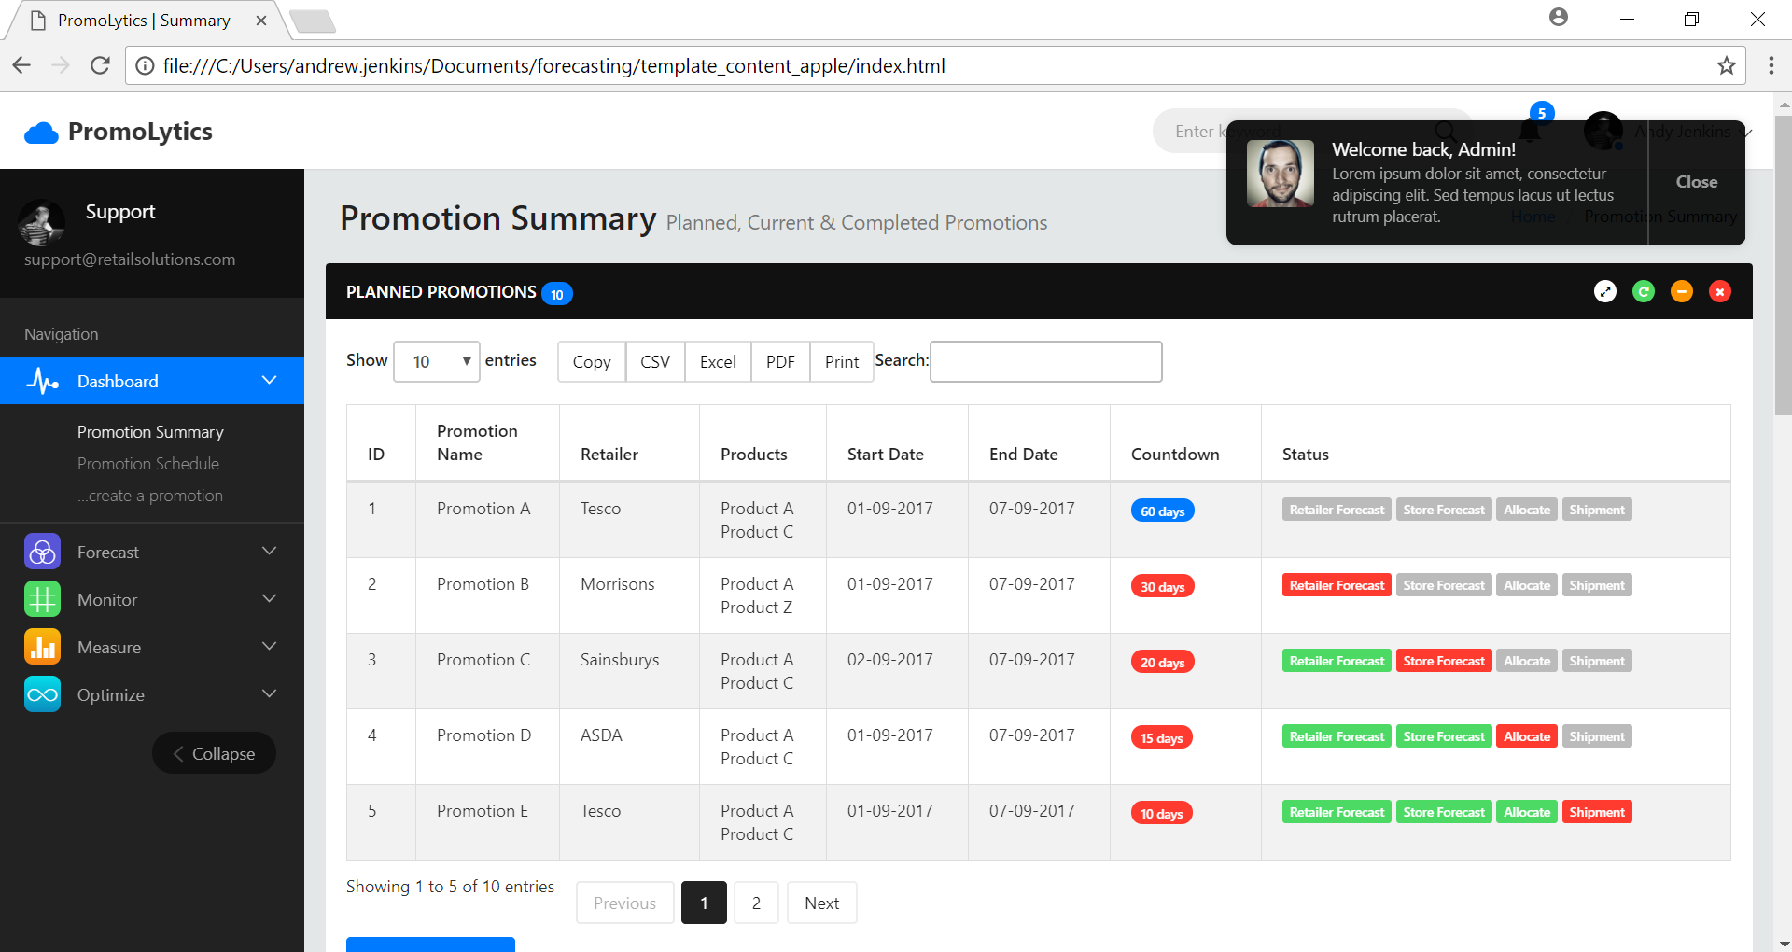
Promotion Summary – Planned Promotions

Slide 4
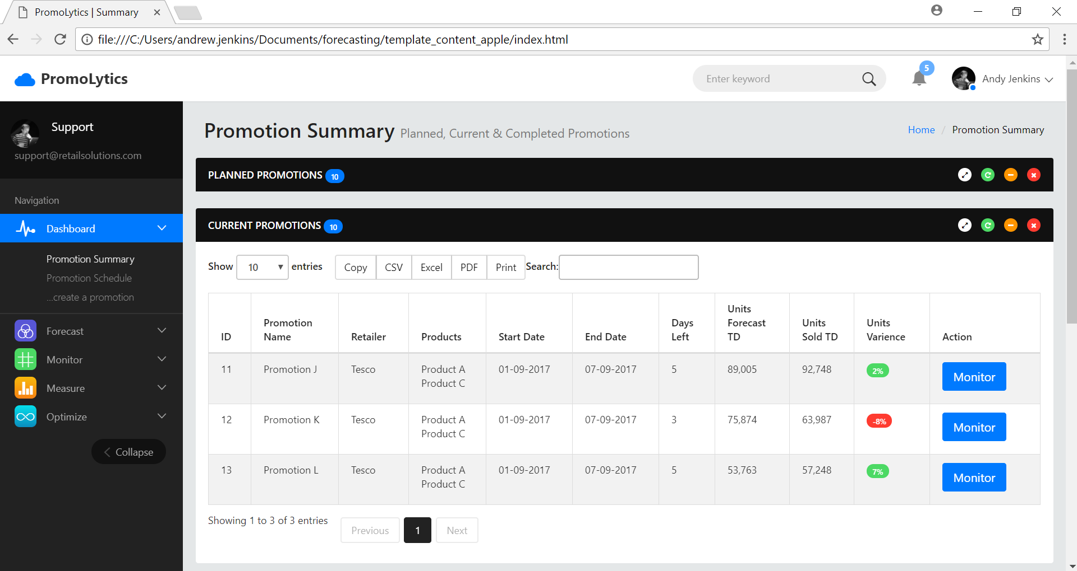
Promotion Summary – Current Promotions

Slide 5
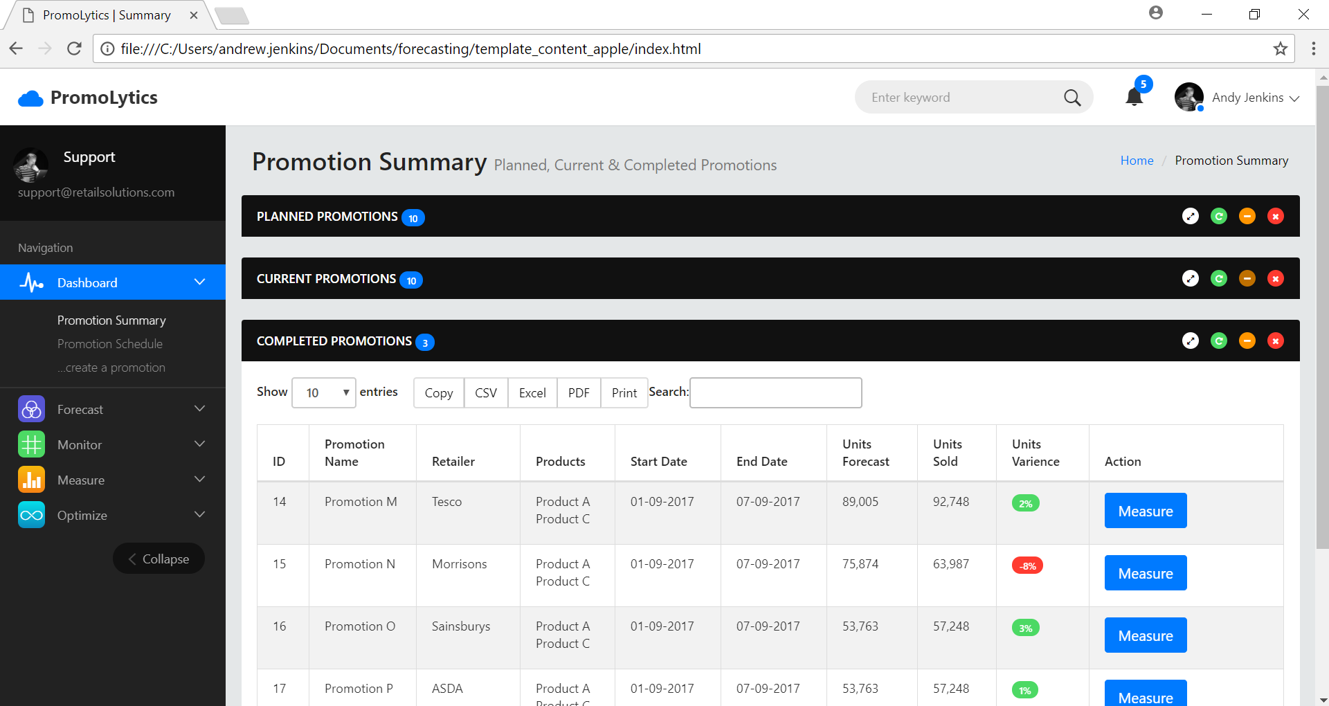
Promotion Summary – Completed Promotions

Slide 6
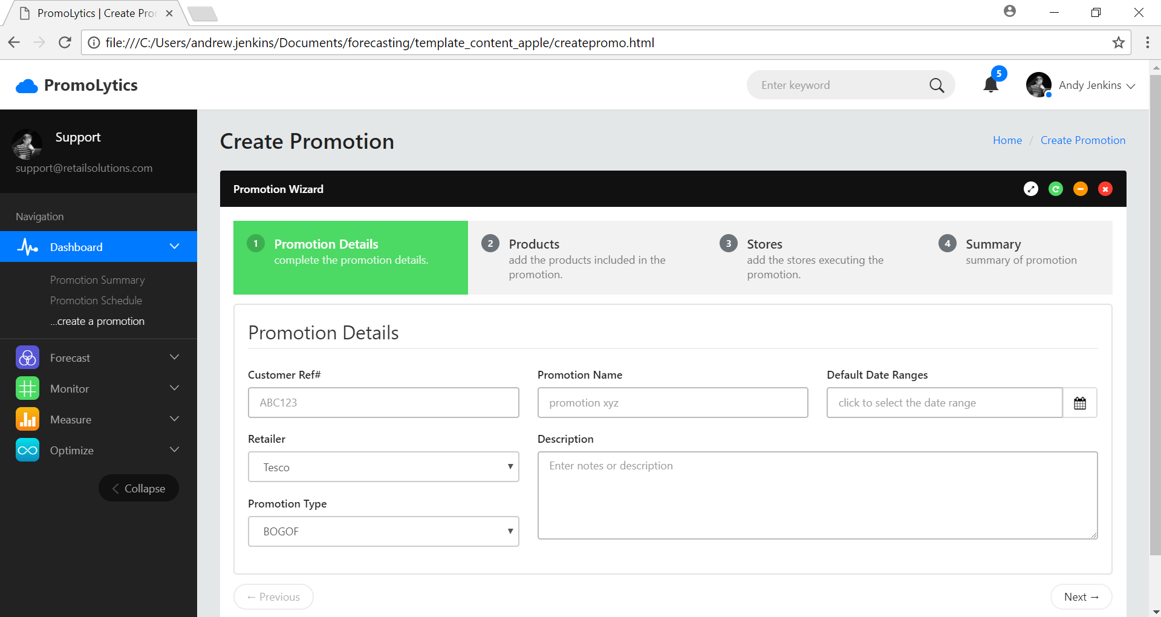
Create Promotion Wizard – Step 1

Slide 7
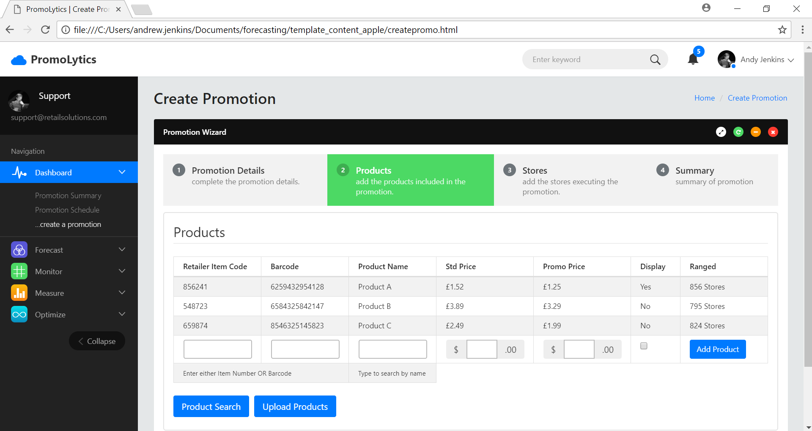
Create Promotion Wizard – Step 2

Slide 8
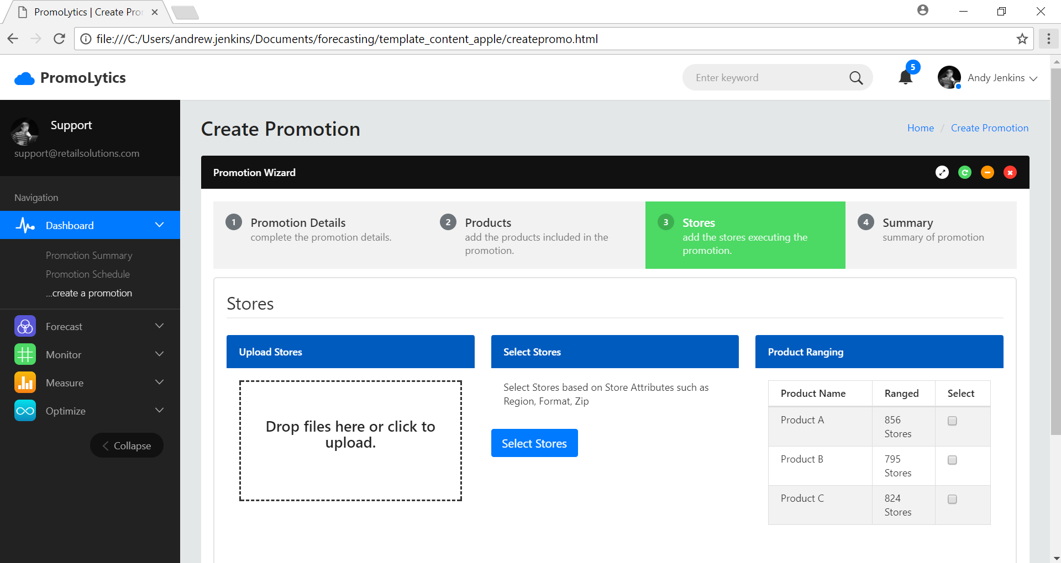
Create Promotion Wizard – Step 3

Slide 9
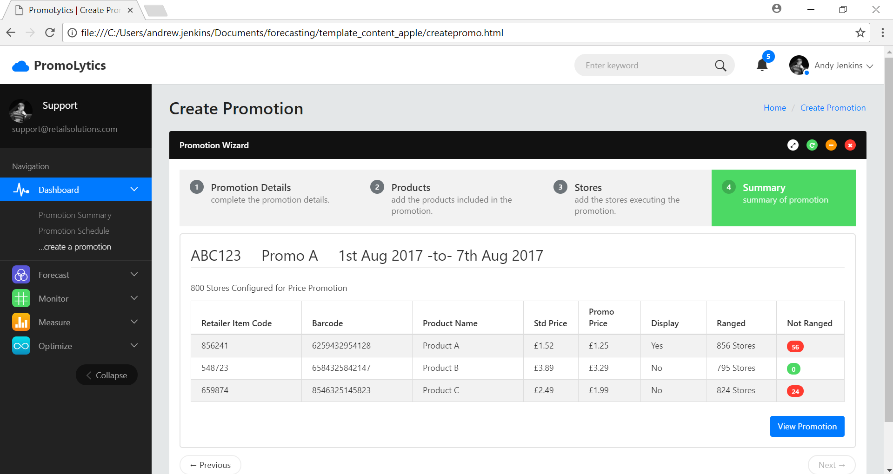
Create Promotion Wizard – Step 4

Slide 10
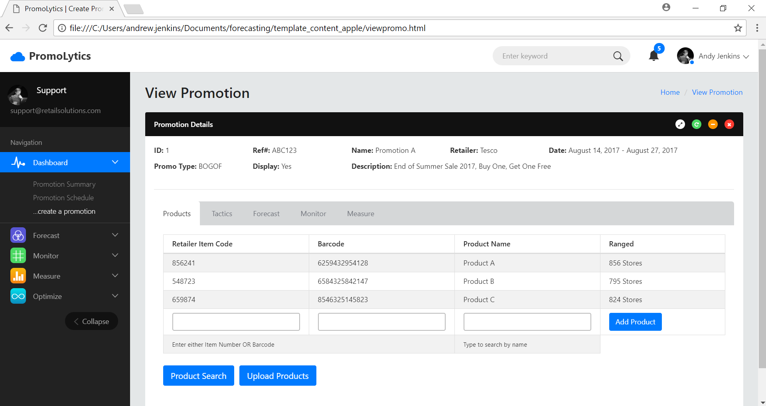
View Promotion - Products

Slide 11
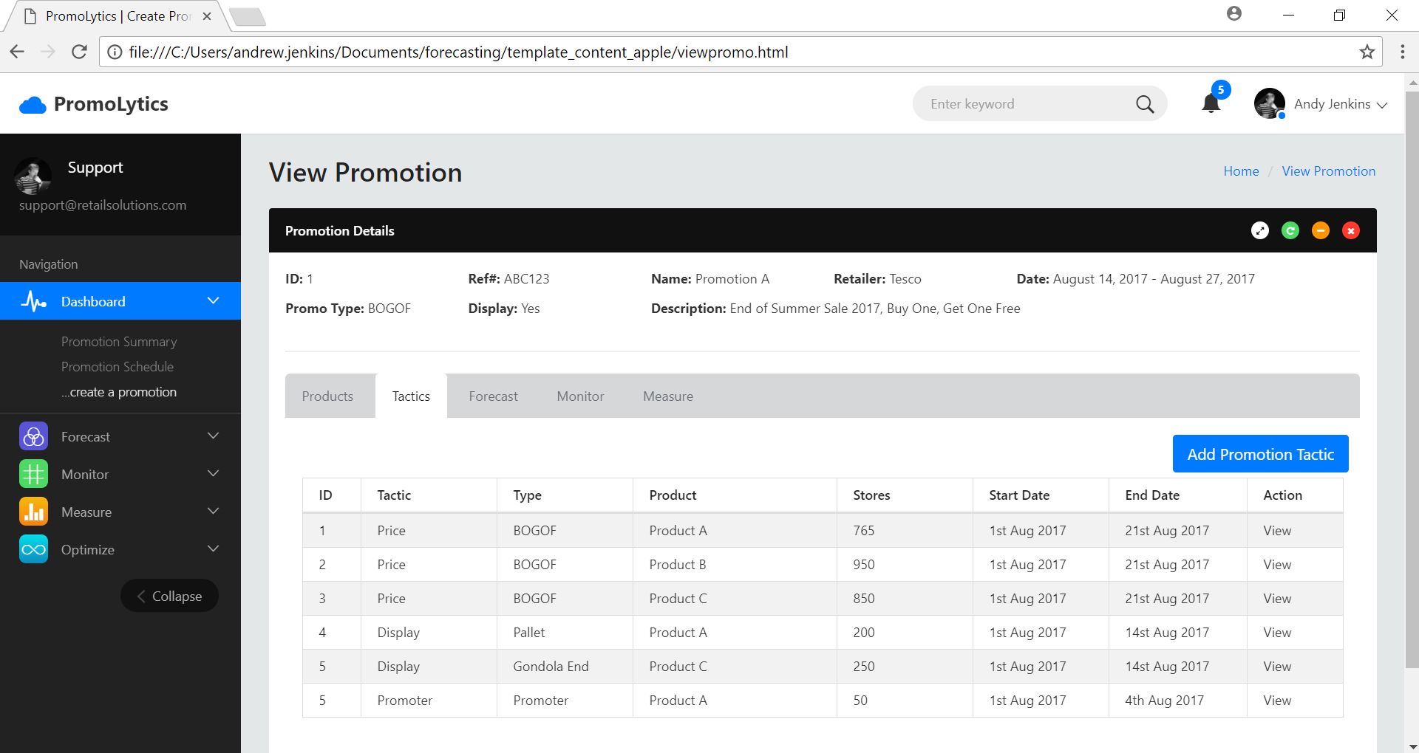
View Promotion - Tactics

Slide 12
Conceptual Architecture
Forecast
Export
Promo Mgmt.
- CRUD
- Calendar
Forecast
- Select Historical Promos
- Stock Allocations
- Shipment Orders
SSO
CPG
Promo
Def
Promo DB
Forecast Algos
- Method 1
- Method 2
Stock Allocation
- Method 1
- Method 2
Shipment Calculations
- Method 1
- Method 2
Promo
Calendar
Promo Flag
Promo Detection
Retailer
POS Data

